Slide 1

BITCOIN CRYPTOCURRENCY
PRESENTED BY:
UDAY PRATAP SINGH
SHIVA SRIVASTAVA
DHEERAJ SHARMA
RITIKA SINGH
Guided by:
Mr. SAKHIB AKHTAR KHAN
Mentored by: Kuldeep Sir (IKIGAI LAB)

Slide 2


Slide 3
Exploring the Bitcoin Cryptocurrency Market
In this Project we can understand the growth and impact of Bitcoin and other cryptocurrencies.
Explore the market capitalization of different Cryptocurrencies using Python Big Data.
Big Data Analytics:
Big Data analytics refers to the methods, tools and application used to collect, process and derive insights from varied, high-volume, high-velocity data sets.
Data sets may come from a variety of sources, such as web, mobile, email, social media and networked smart devices.
Data may be in CSV, JSON and other format.
Traditional forms of data analysis software aren’t equipped to support this level of complexity and scale, which is where the systems tools, and applications designed specifically for big data analysis come into play.

Slide 4
What is use in this Project?
We are using following software and tools:
Python language for data visualization
Jupyter Notebook
Modules required in Python
1) matplotlib module
2)Pandas module
Use Official documentation for reference
pandas documentation — pandas 1.4.2 documentation (pydata.org)
Matplotlib documentation — Matplotlib 3.5.2 documentation
Cryptocurrency.csv file that consist all data.
https://github.com/hacker123shiva/Python_project.git

Slide 5
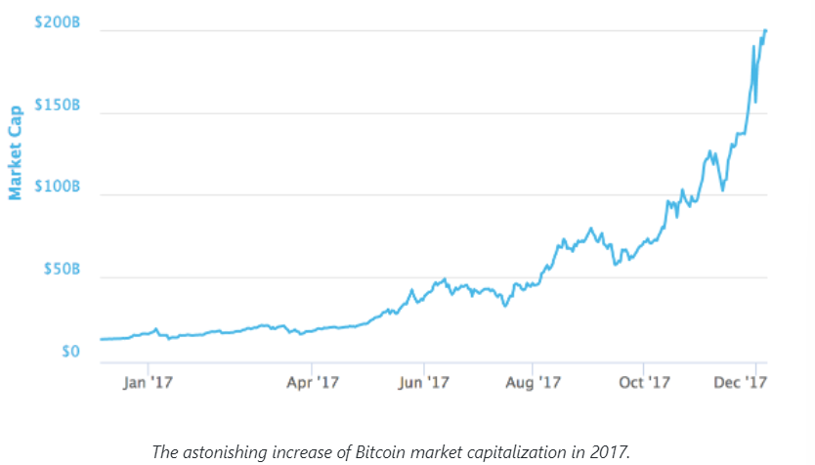
Something About Bitcoin Cryptocurrency
Market
Since the launch of Bitcoin in 2008, hundreds of similar projects based on the blockchain technology have emerged. We call these cryptocurrencies (also coins or cryptos in the Internet slang). Some are extremely valuable nowadays, and others may have the potential to become extremely valuable in the future¹. In fact, on the 6th of December of 2017, Bitcoin has a market capitalization above $200 billion.
WARNING: The cryptocurrency market is exceptionally volatile² and any money you put in might disappear into thin air

Slide 6
Problem Under this Project:
1. Bitcoin and Cryptocurrencies: Full dataset, filtering, and reproducibility
2. Discard the cryptocurrencies without a market capitalization
3. How big is Bitcoin compared with the rest of the cryptocurrencies?
4. Making the plot easier to read and more informative
5. What is going on?! Volatility in cryptocurrencies
6. Well, we can already see that things are a bit crazy
7. Ok, those are... interesting. Let's check the weekly Series too.
8. How small is small?
9. Most coins are tiny

Slide 7
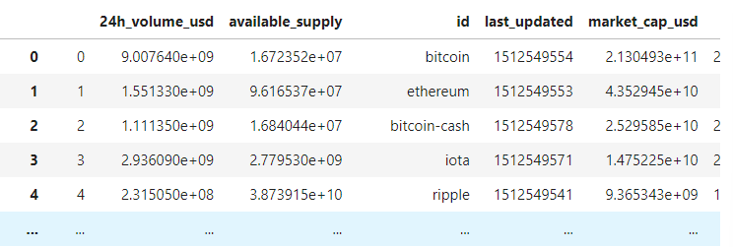
Bitcoin and Cryptocurrencies: Full dataset, filtering,
and reproducibility
Reading datasets cryptocurrency.csv into Pandas
Code:
# importing pandas
import pandas as pd
#importing matplotlib
import matplotlib.pyplot as plt
# Reading datasets cryptocurrency.csv into pandaas
dataset=pd.read_csv("cryptocurrency.csv“)
View of Dataframe:
1326 rows × 16 columns

Slide 8
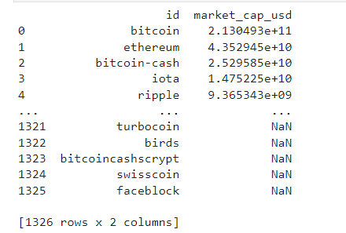

Selecting the ‘id’ and ‘market_cap_usd’ columns
Code:
ds1=dataset[['id','market_cap_usd’]]
View of Dataframe ds1:
Counting number of values
Code:
print(f"id_count: {ds1['id'].count()}\nmarket_cap_usd_count: {ds1['market_cap_usd'].count()}")
Output:
id_count: 1326
market_cap_usd_count: 1031

Slide 9
Discard the cryptocurrencies without a market capitalization
Why do we count() for id and market_cap_usd differ above?
It is because some cryptocurrency listed in coinmarket.com have no known market capitalization, this is represented by NaN in the data, and NaN are not counted by count(). These cryptocurrencies are of little interest to us in this anlaysis, so they are safe to remove.
Filtering out rows without a market capitalization
CODE:
ds2=dataset.dropna(subset=['market_cap_usd'])
print('id_count: ',ds2['id'].count(),'\n','market_cap-usd_count: ',ds2['market_cap_usd'].count(),sep=‘’)
Output:
id_count: 1031
market_cap-usd_count: 1031

Slide 10
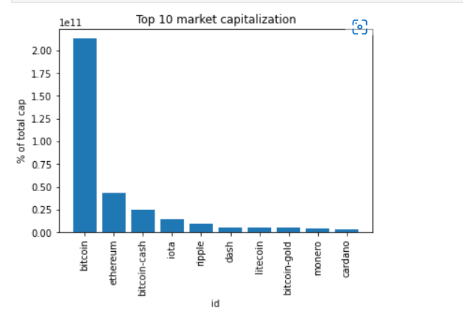
How big is Bitcoin compared with the rest
the cryptocurrencies?
At the time of writing, Bitcoin is under serious competition from other projects, but it is still dominant in market capitalization. Let's plot the market capitalization for the top 10 coins as a barplot to better visualize this.
TOP_CAP_TITLE = 'Top 10 market capitalization'
TOP_CAP_YLABEL = '% of total cap'
# Selecting the first 10 rows and setting the index
first10=dataset.iloc[0:10].set_index('id')
# Calculating market_cap_perc
first10=first10.assign(market_cap_perc=lambda x:(x.market_cap_usd/dataset.market_cap_usd.sum()*100))
# Plotting the barplot with the title defined above
plt.bar(first10.index.values,first10['market_cap_usd'])
plt.xticks(rotation=90)
plt.title('Top 10 market capitalization')
plt.xlabel('id’)
# Annotating the y axis with the label defined above
plt.ylabel(TOP_CAP_YLABEL)
plt.show()

Slide 11
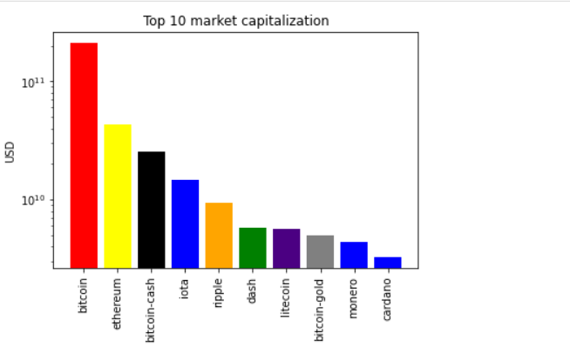
Making the plot easier to read and more informative
While the plot above is informative enough, it can be improved. Bitcoin is too big, and the other coins are hard to distinguish because of this. Instead of the percentage, let's use a log¹⁰ scale of the "raw" capitalization. Plus, let's use color to group similar coins and make the plot more informative
Code and Subproblem:
c = ['red', 'yellow', 'black', 'blue', 'orange','green','indigo','grey','blue','blue’]
#Plotting market_cap_usd as before but adding the colors
plt.bar(first10.index.values,first10['market_cap_usd'],color=c )
plt.xticks(rotation=90)
plt.title('Top 10 market capitalization')
#scaling the y-axis
plt.yscale('log')
plt.xlabel('id')
# Annotating the y axis with 'USD'
plt.ylabel('USD')
# Final touch! Removing the xlabel as it is not
Very imformative
plt.xlabel('')
plt.show()

Slide 12
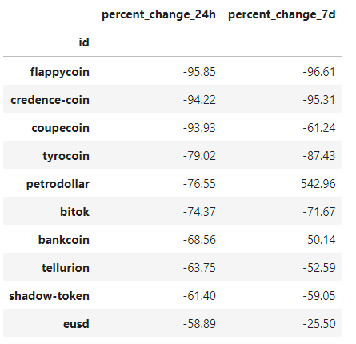
What is going on? Volatility in cryptocurrencies
The cryptocurrencies market has been spectacularly volatile since the first exchange opened. This notebook didn't start with a big, bold warning for nothing. Let's explore this volatility a bit more! We will begin by selecting and plotting the 24 hours and 7 days percentage change, which we already have available.
Code and Problem:
volatility = dataset[['id', 'percent_change_24h', 'percent_change_7d']]
# Setting the index to 'id' and dropping all NaN rows
volatility=volatility.set_index('id').dropna()
# Sorting the DataFrame by percent_change_24h in ascending order
volatility=volatility.sort_values(by='percent_change_24h',ascending=True)
#checking the first few rows
volatility.head(10)

Slide 13
Well, we can already see that things are a bit crazy
It seems you can lose a lot of money quickly on cryptocurrencies. Let's plot the top 10 biggest gainers and top 10 losers in market capitalization.
Code and subproblem:
# Annotating the y axis with the label defined above
plt.ylabel(TOP_CAP_YLABEL)
plt.show()
#Defining a function with 2 parameters, the series to plot and the title
def top10_member_plot(input_dataset,title):
# Making the subplot and the figure for two side by side plots
plt.subplot(1,2,1)
plt.bar(input_dataset[0:10].index.values,input_dataset[0:10],color='blue')
plt.xticks(rotation=90)
# Setting the figure's main title to the text passed as parameter
plt.suptitle(title)

Slide 14

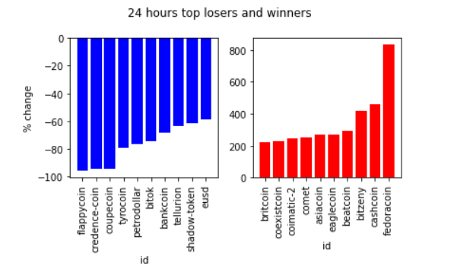
# Setting the ylabel to '% change'
plt.ylabel('% change')
plt.xlabel("id")
# Same as above, but for the top 10 winners
plt.subplot(1,2,2)
plt.bar(input_dataset[-10:].index.values,input_dataset[-10:],color='red')
plt.tight_layout()
plt.xticks(rotation=90)
plt.xlabel("id")
plt.show()
DTITLE='24 hours top losers and winners'
# Calling the function above with the 24 hours period series and title DTITLE
top10_member_plot(volatility.percent_change_24h,DTITLE)
Output:

Slide 15
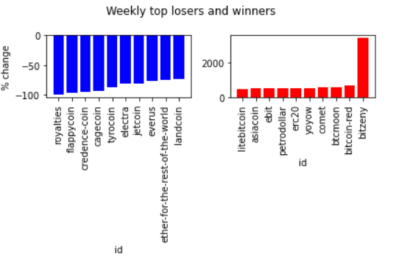
Ok, those are... interesting. Let's check the weekly Series too
800% daily increase?! Why are we doing this tutorial and not buying random coins?
After calming down, let's reuse the function defined above to see what is going weekly instead of daily.
Please take a moment to understand the implications of the red plots on how much value some cryptocurrencies lose in such short periods of time
Code and Problem:
volatility_weekly= volatility.sort_values(by='percent_change_7d', ascending=True)
WTITLE = "Weekly top losers and winners“
# Calling the top10_subplot function
top10_member_plot(volatility_weekly.percent_change_7d,WTITLE)

Slide 16
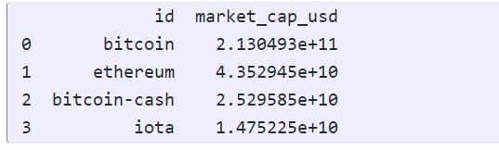
How small is Small?
The names of the cryptocurrencies above are quite unknown, and there is a considerable fluctuation between the 1 and 7 days percentage changes. As with stocks, and many other financial products, the smaller the capitalization, the bigger the risk and reward. Smaller cryptocurrencies are less stable projects in general, and therefore even riskier investments than the bigger ones¹. Let's classify our dataset based on Investopedia's capitalization definitions for company stocks.
Code and Subproblem:
# Selecting everything bigger than 10 billion
largecaps=dataset[dataset['market_cap_usd'] >= 10000000000][['id','market_cap_usd']]
# printing out largecaps
print(largecaps)
Output:

Slide 17
Most coins are tiny
Note that many coins are not comparable to large companies in market cap, so let's divert from the original Investopedia definition by merging categories
Code and Subproblem:
cap=pd.read_csv('cryptocurrency.csv')
# Making a nice function for counting different marketcaps from the
# "cap" DataFrame. Returns an int.
def capcount(query_string):
return cap.query(query_string).count().id
# Labels for the plot
LABELS = ["biggish", "micro", "nano"]
# Using capcount count the biggish cryptos
biggish = capcount('market_cap_usd > 3E+8')
# Same as above for micro ...
micro = capcount('market_cap_usd > 50000000 and market_cap_usd < 300000000')
# ... and for nano
nano = capcount('market_cap_usd < 50000000)

Slide 18

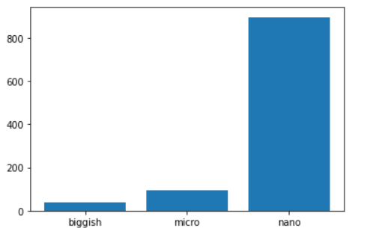
# Making a list with the 3 counts
values = [biggish, micro, nano]
# Plotting them with matplotlib
plt.bar(height=values, x=LABELS);
Output:

Slide 19


